Slide 1
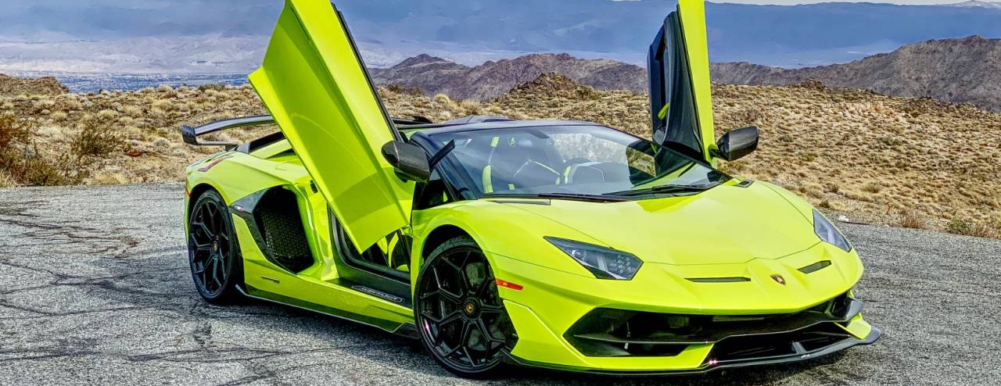
CS371 Final Project: FAST AND FURIOUS
By Bishesh Tuladhar and Pukar Mahat

Slide 2
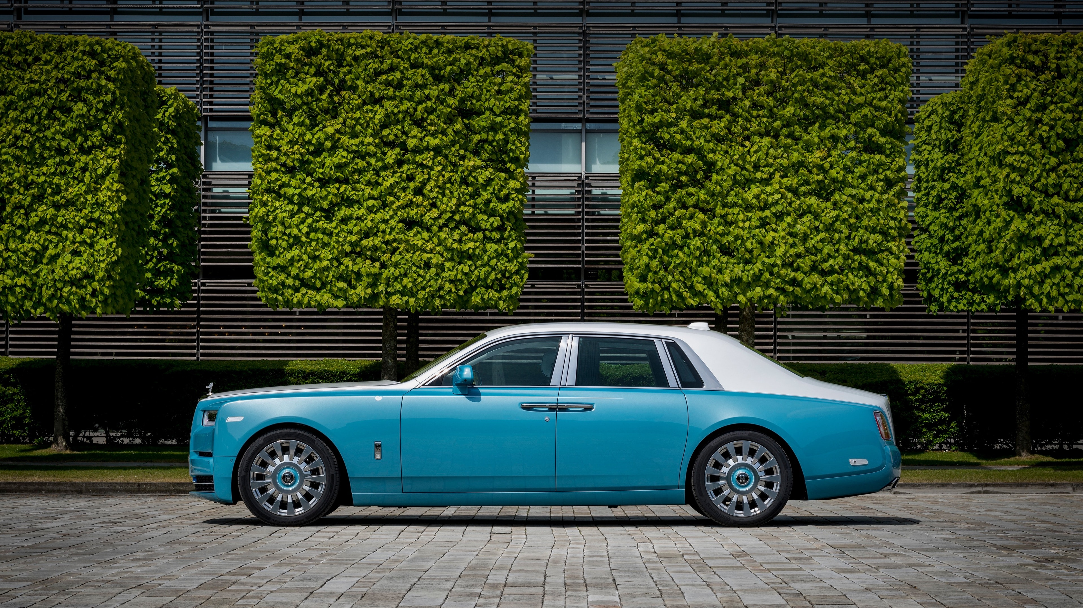
Objective
Learn about Windows Presentation Foundation and its implementation
Learn about C#, game design
Pair Programming

Slide 3
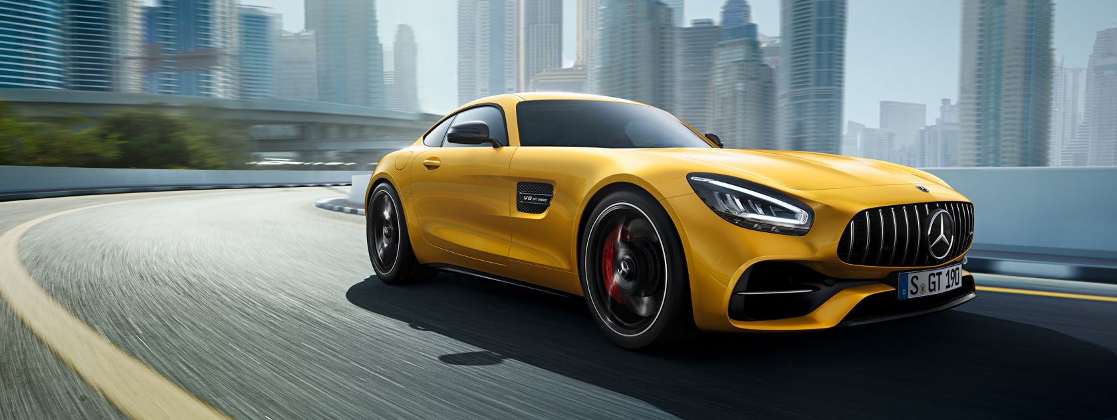
Game components
Player
AI cars
Road Tracks
Hit Boxes

Slide 4

Challenges
Car and Road Animation
Time Cycle for the game
Hit Box and collision detection
AI manipulation
Sounds

Slide 5
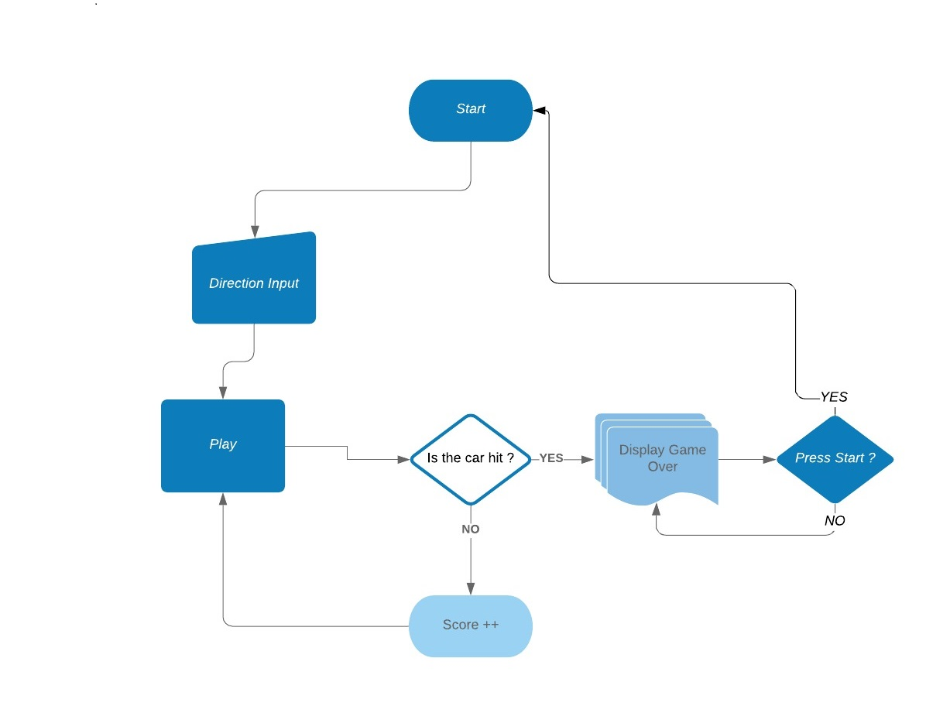
FLOW CHART

Slide 6

QUESTIONS ?

Slide 7
Picture links
https://www.google.com/search?q=lamborghini&rlz=1C1CHZL_enUS711US711&sxsrf=ACYBGNSPzGpsjBgUfJt96bchVAeU1E3jiA:1579847307268&source=lnms&tbm=isch&sa=X&ved=2ahUKEwjc9bHszZvnAhX3FjQIHRBoDc8Q_AUoAXoECA0QAw&biw=1536&bih=722#imgrc=gKWLRI-1fXD4JM:
https://www.google.com/search?q=rolls+royce&rlz=1C1CHZL_enUS711US711&sxsrf=ACYBGNQ63so1fYgffCnCX9pidNNfsUMq2A:1579853694445&tbm=isch&source=iu&ictx=1&fir=sLimhmBihc7ykM%253A%252CxbeaaCm7T7k43M%252C_&vet=1&usg=AI4_-kRR3g-KleK5lJuf2L5tKFmWzKMFTA&sa=X&ved=2ahUKEwijoYTS5ZvnAhXGqp4KHWHYBeQQ9QEwBXoECAwQOA#imgrc=sLimhmBihc7ykM:
https://www.google.com/search?rlz=1C1CHZL_enUS711US711&biw=1536&bih=722&tbm=isch&sxsrf=ACYBGNT-1b_kyw3Uj_J6Q4g2rL6sPy2MBA%3A1579853903578&sa=1&ei=T6gqXu7uIpbL-gSYprWAAw&q=mercedes+amg&oq=mercedes+amg&gs_l=img.3..0i67l7j0l3.16700.18754..18868...3.0..0.73.881.14......0....1..gws-wiz-img.......35i39j0i131j0i3.ckjFMiYrcLU&ved=0ahUKEwiu0uC15pvnAhWWpZ4KHRhTDTAQ4dUDCAc&uact=5#imgrc=U58YUuqS1-N3vM:
https://www.google.com/search?hl=en&biw=1536&bih=722&tbm=isch&sxsrf=ACYBGNQG7S_yGPBU6HBvJvNLLP77ZCtXKA%3A1579854497971&sa=1&ei=oaoqXoXrOsX3-gSa-rmQCg&q=swiss+alps&oq=swiss+&gs_l=img.3.2.0i67l5j0l4j0i67.14220.31390..34208...5.0..0.133.1255.1j10......0....1..gws-wiz-img.....10..35i39j35i362i39.ArndLRsVBRc#imgrc=JtLgVpATppjxDM:

